Slide 1
ONLINE BANKING SYSTEM
Shriya Prasanna (PsNo:10665479)
Sowndariya Kamaraj (PsNo:10665609)
Marni Neeharika (PsNo:10665491)
Kshama Sharma (PsNo:10665768)
Kumaran KS (PsNo:10665541)

Slide 2
INTRODUCTION
Online banking, also known as internet banking, is an electronic payment system that enables customers of a bank or other financial institution to conduct a range of financial transactions through the financial institution's website. The online banking system will typically connect to or be part of the core banking system operated by a bank and is in contrast to branch banking which was the traditional way customers accessed banking services.
Some banks operate as a "direct bank" (or “virtual bank”), where they rely completely on internet banking.
Internet banking software provides personal and corporate banking services offering features such as viewing account balances, obtaining statements, checking recent transaction and making payments.

Slide 3
OBJECTIVES
Viewing account balance.
Viewing current transactions.
Viewing bank statement.
Ordering cheque books.
Download periodic account statements.
Downloading applications for Mobile-banking, internet-banking etc.
Bank customers can transact banking tasks through online banking, including.

Slide 4
MODULES
LOR
DASHBOARD

Slide 5
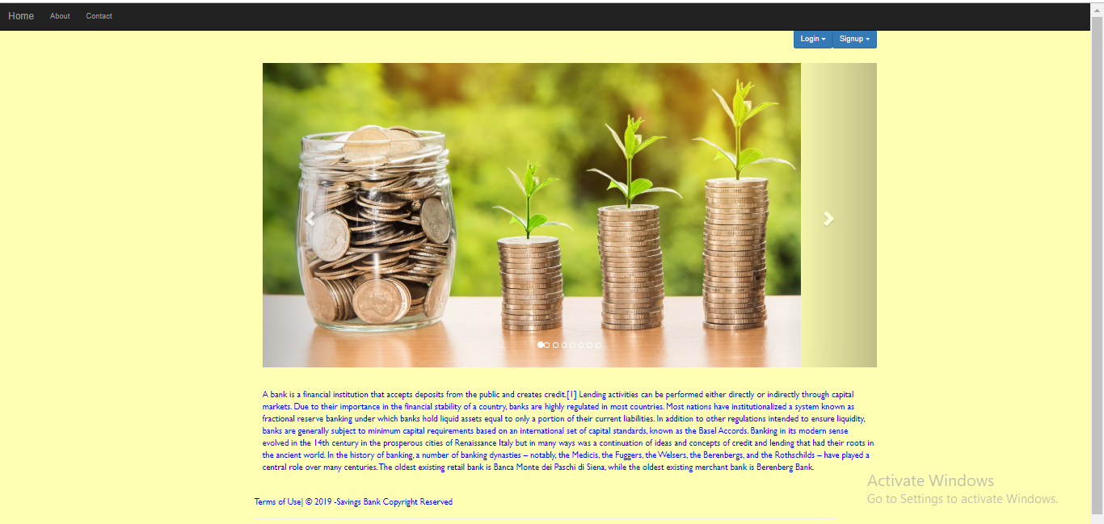
LOR
In this module there will be a home page where the user will first have to login if he/she already has an account or signup if he/she doesn’t have an account.

Slide 6
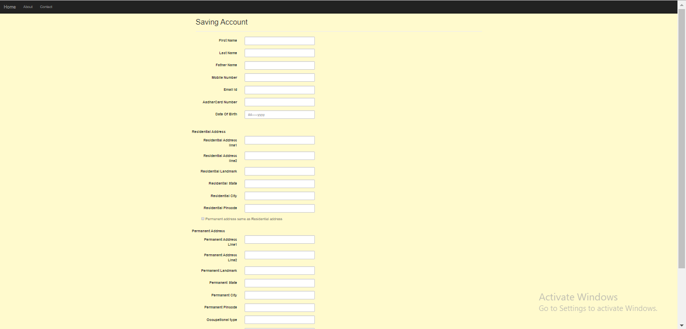
If the user is visiting for the first time then user will have to click on the sign up button and will be directed to the Savings Account page where the user has to enter the all necessary required details mentioned on that page and then click on the ‘SUBMIT’ button, after which the user again will be directed to the homepage

Slide 7
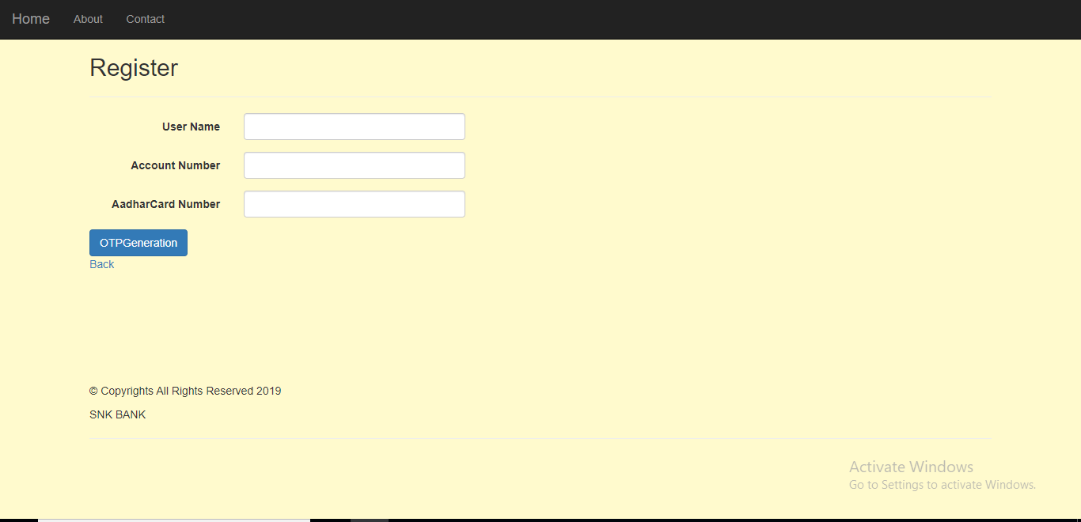
The user after opening savings account ,has to register by clicking on registration button. The user has to enter the all necessary required details mentioned on that page and then click on the ’OTP GENERATION’ button .The OTP will be generated and sent to the mail ,after which the user will be directed to the ‘Register Confirm’ page.

Slide 8
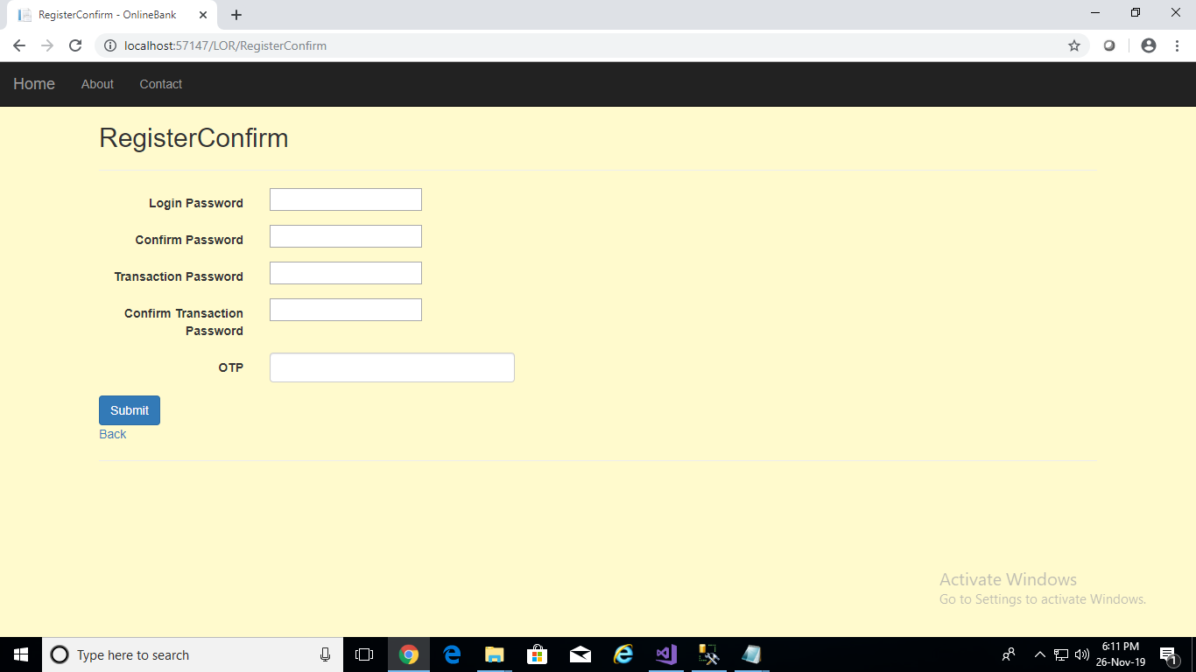
The user must enter the all necessary required details mentioned in the page and press on ‘SUBMIT’ button.

Slide 9
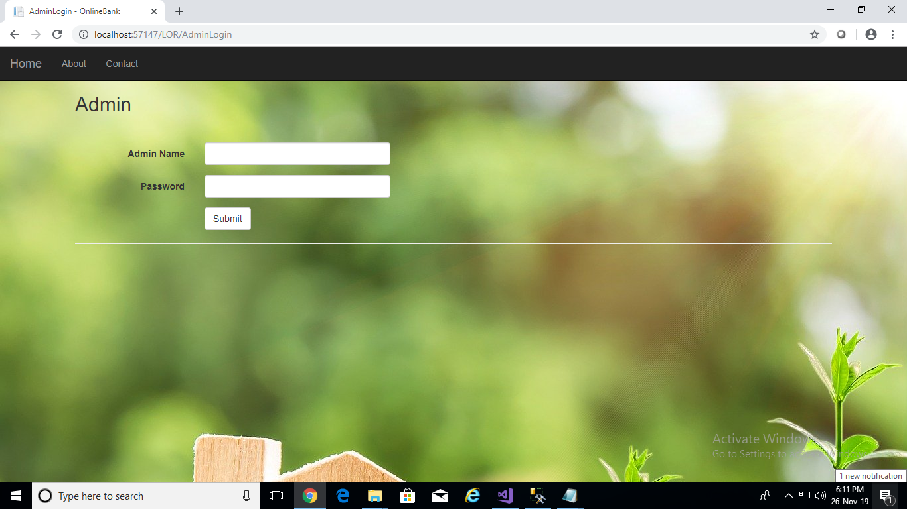
In Admin page, Admin has to enter the details and press on submit button, where he/she will be directed to ‘ADMIN STATUS APPROVAL ‘page.

Slide 10
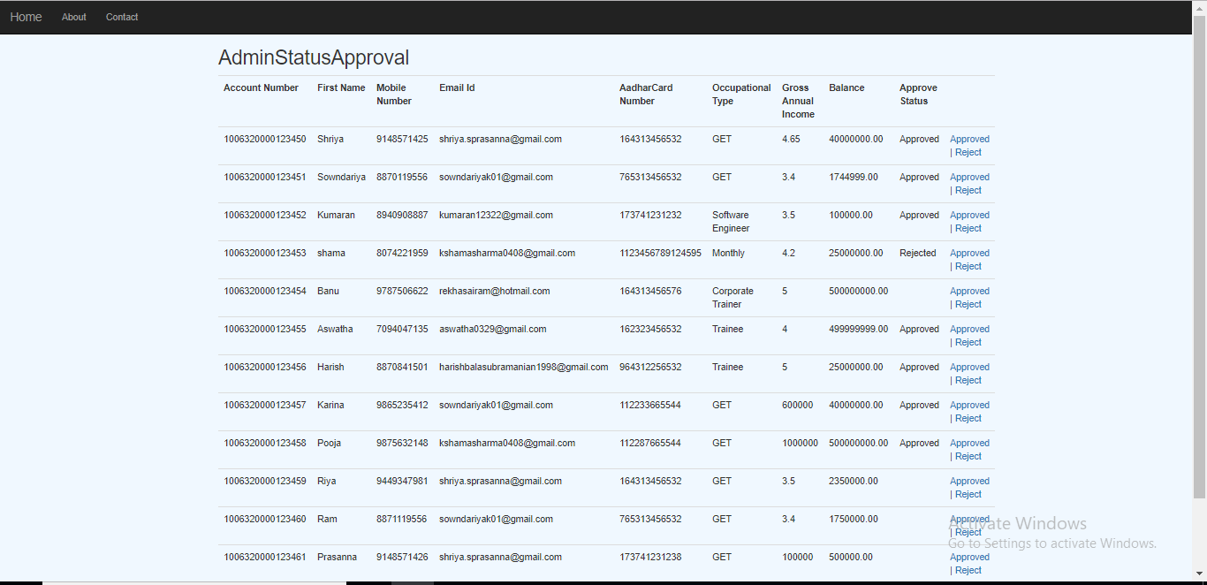
In Admin Status Approval page, the admin can approve / reject the status of user . On which the mail will be sent to their respective registered Email-id. If the status is approved by admin , Account Number will be sent to their respective email id , else rejection mail will be sent to their respective email id.

Slide 11
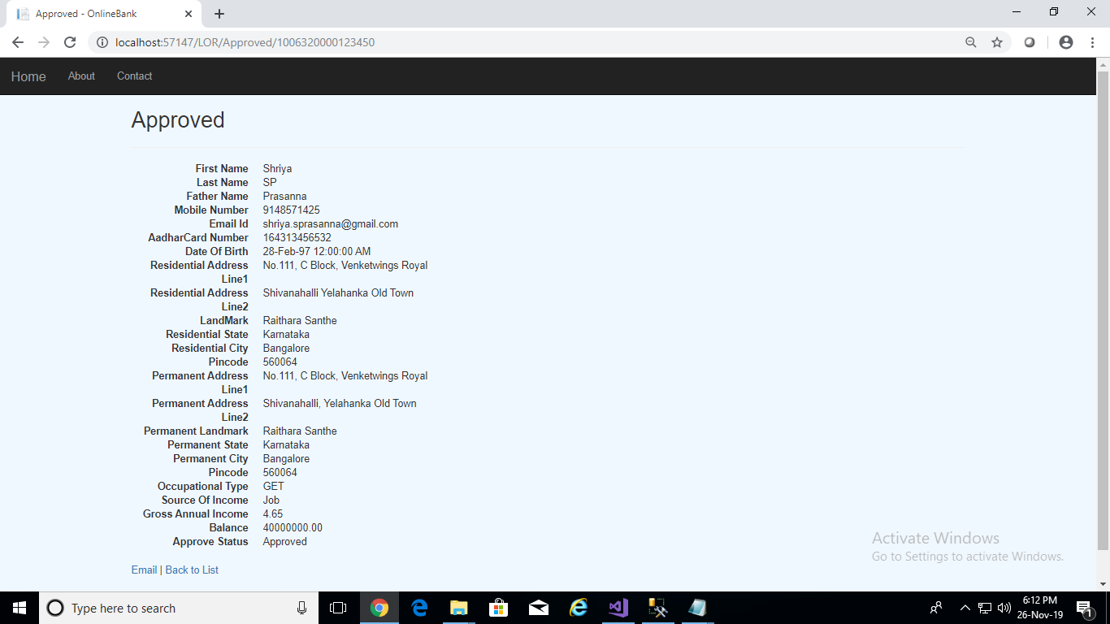
If the admin approves the status , the information of the user will be displayed .

Slide 12
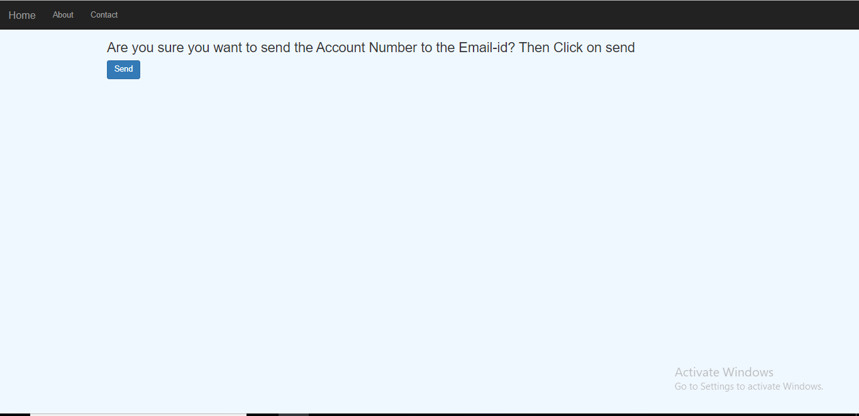
As the account is approved by admin, the account number of the user is sent to the user respective email id.

Slide 13
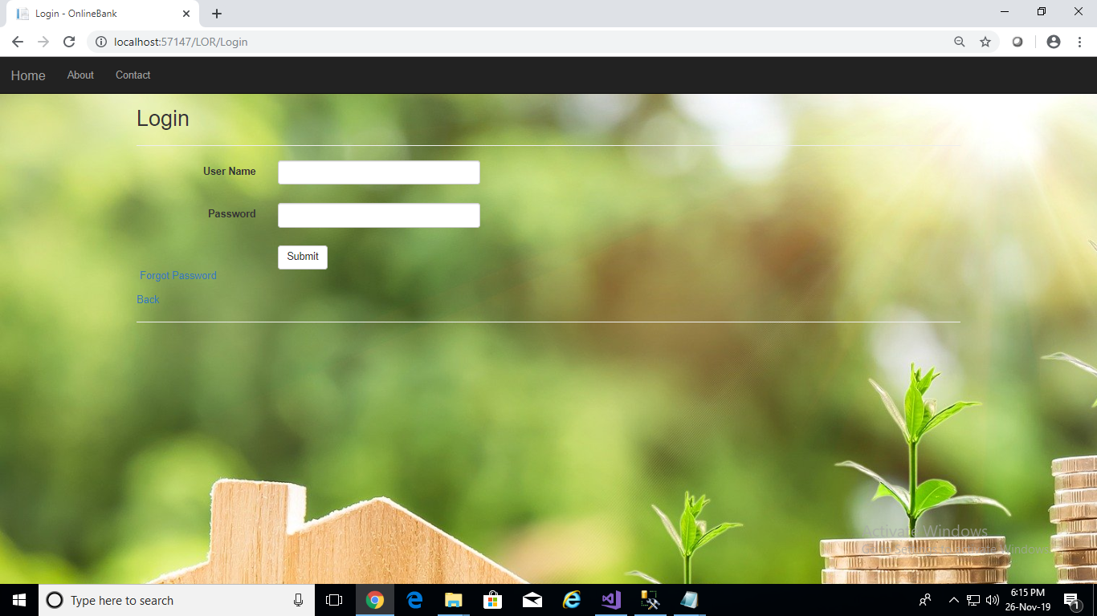
The Login Page of User

Slide 14
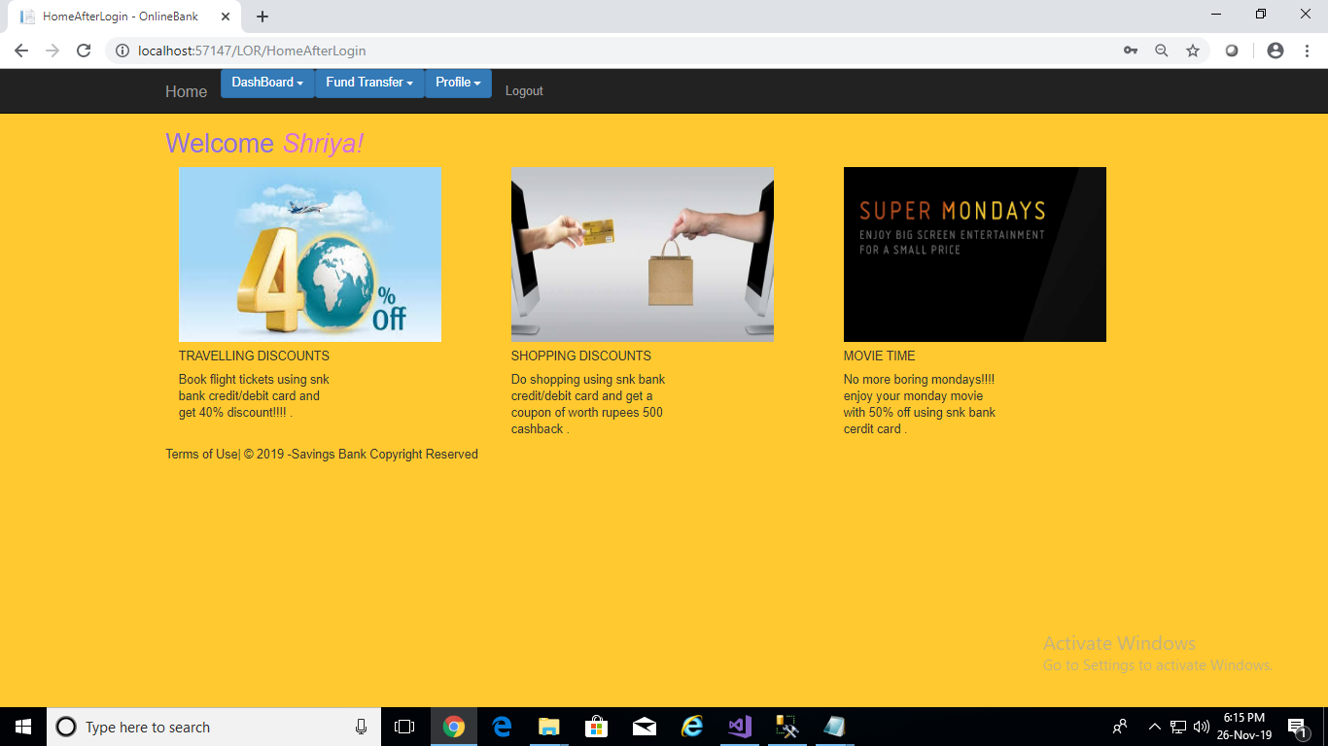
Once the user logs in to his/her account ,the ‘Home After Login’ Page is displayed , where the user has facilities to perform the operations displayed on screen.

Slide 15
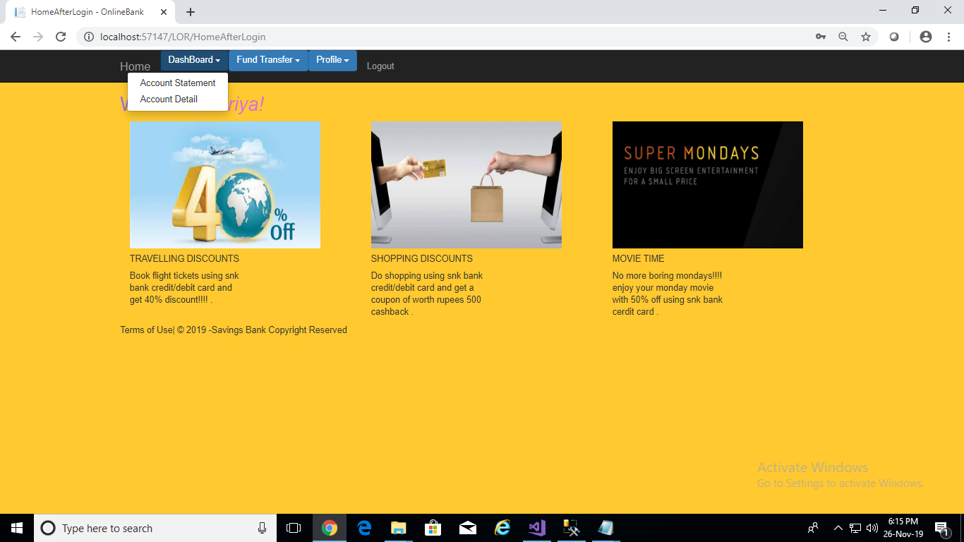
The Dashboard drop-down contains ‘Account Statement’ and ‘Account Details’.

Slide 16
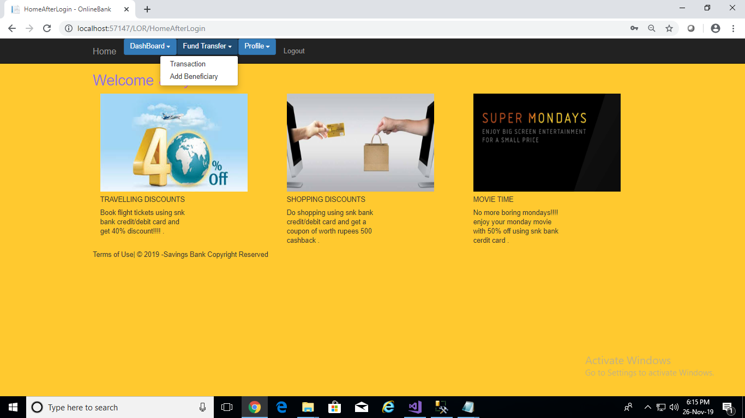
The ‘Fund Transfer ‘ drop-down contains ‘Transaction’ and ‘Add Beneficiary’.

Slide 17
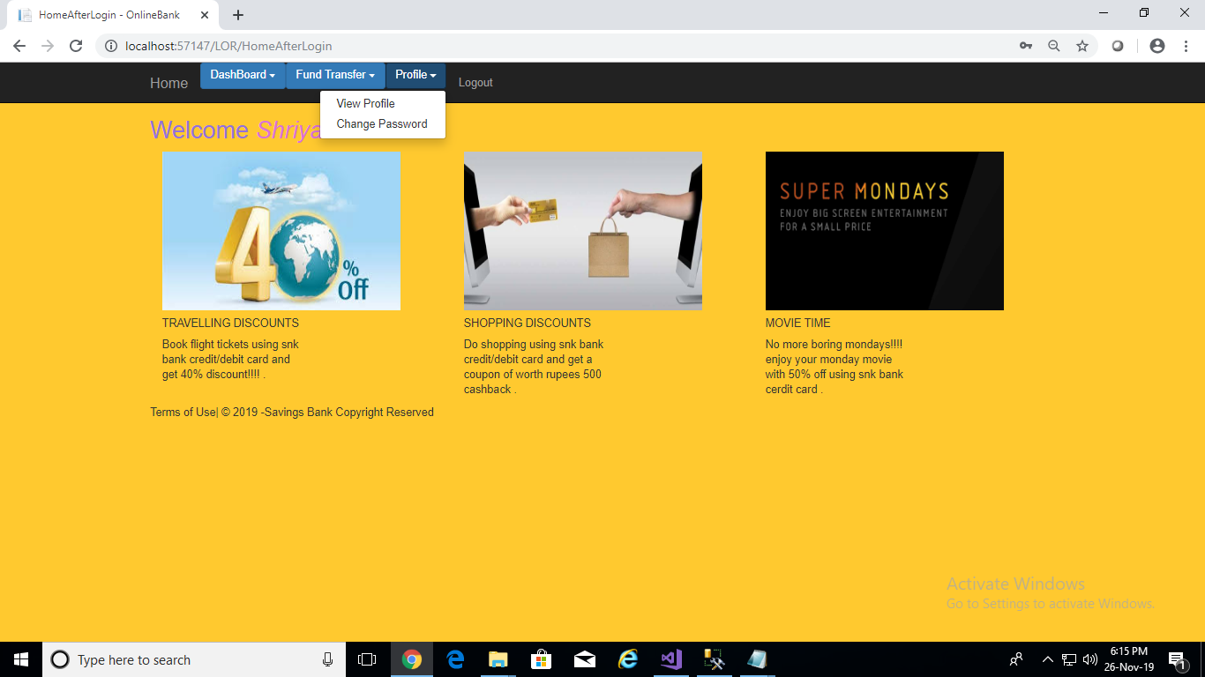
The Profile drop-down contains ‘View profile’ and ‘change password’.

Slide 18
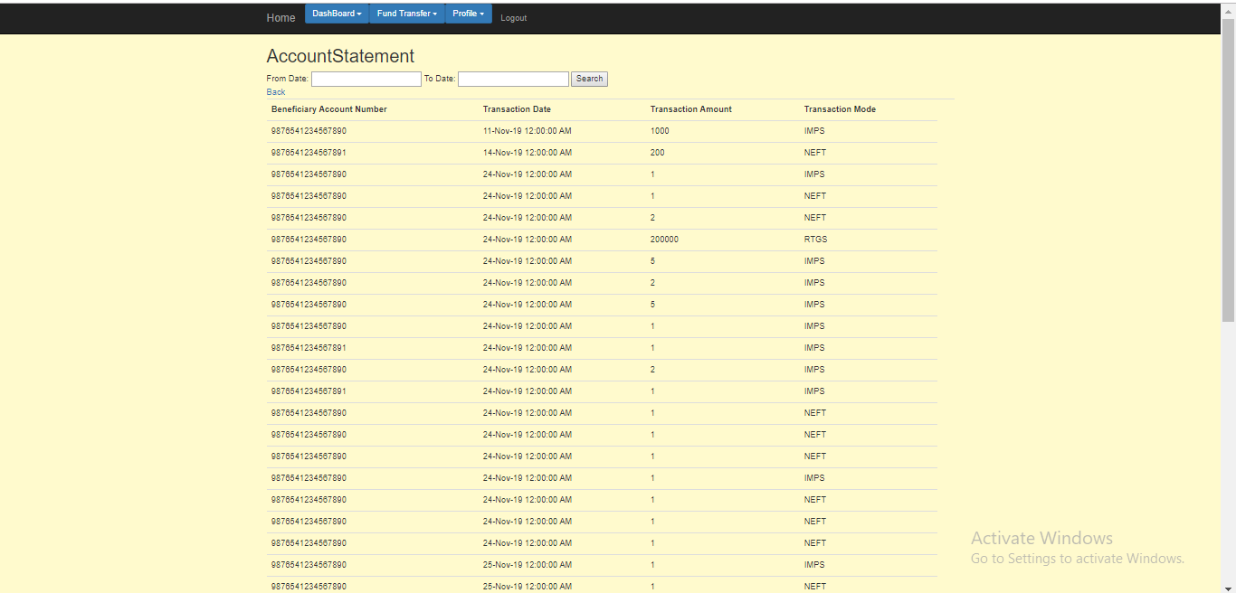
The user will be redirected to ‘Account Statement’ page once he clicks on ‘Account Statement ‘ .
DASHBOARD MODULE

Slide 19
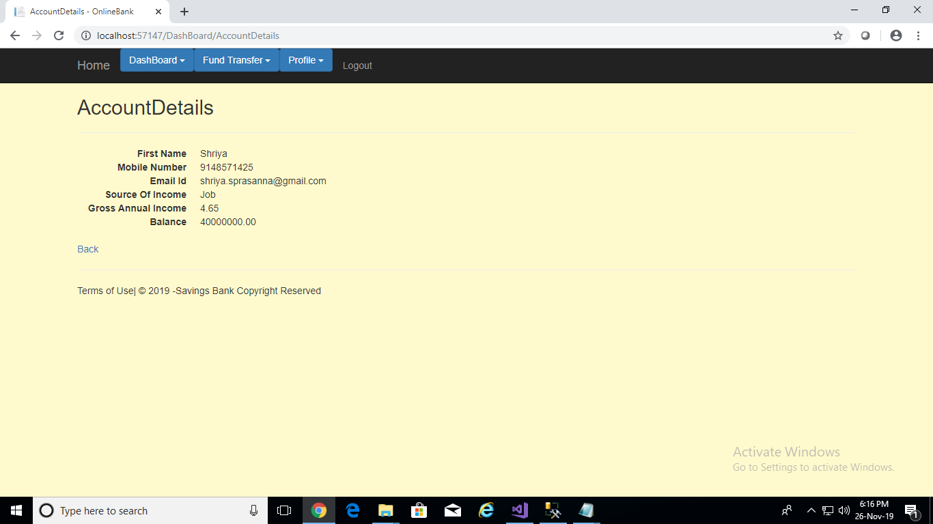
The ‘Account Details’ page of the user

Slide 20
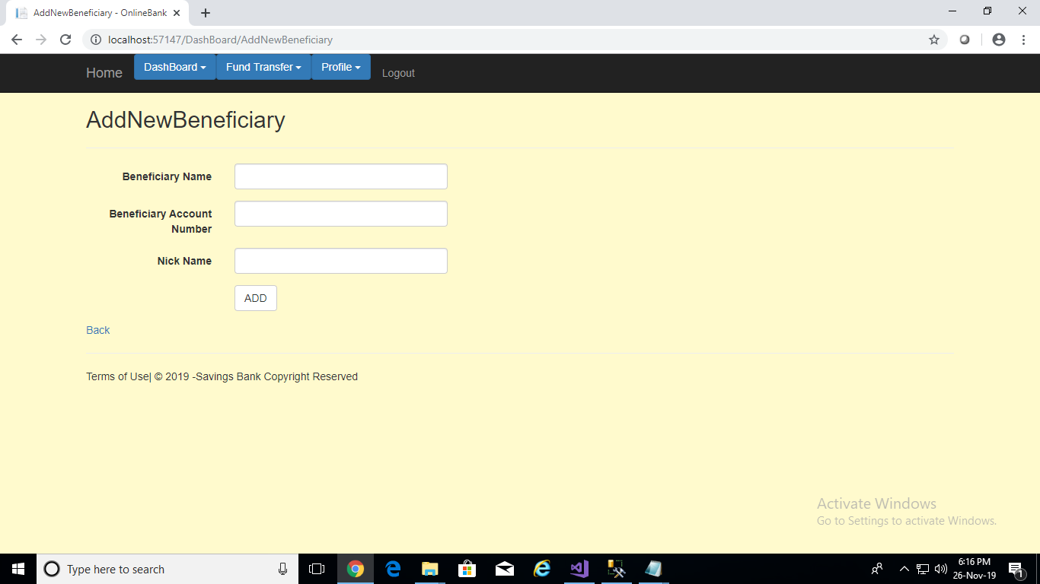
The users can add Beneficiary’s to their account for transferring funds. . The user has to enter the all necessary required details mentioned in the page.

Slide 21
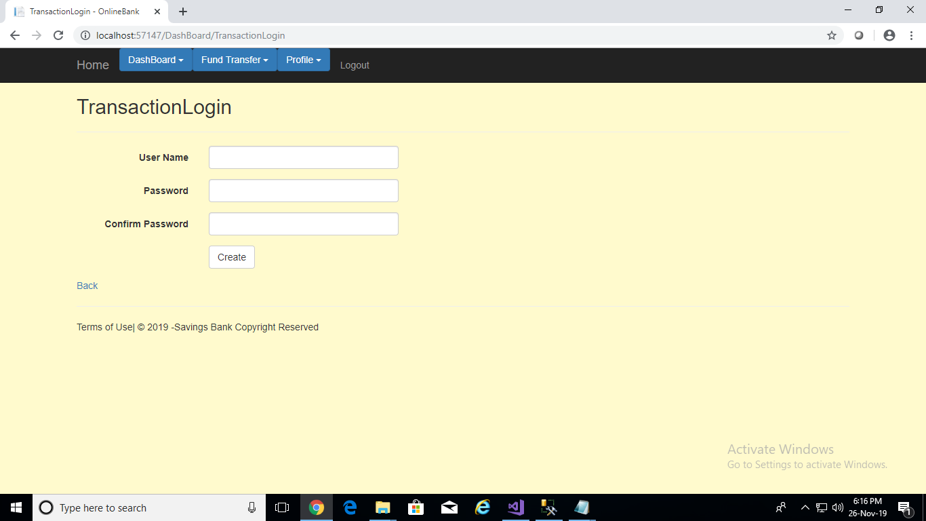
The user has to enter the required details in ‘Transaction Login ‘ page.

Slide 22
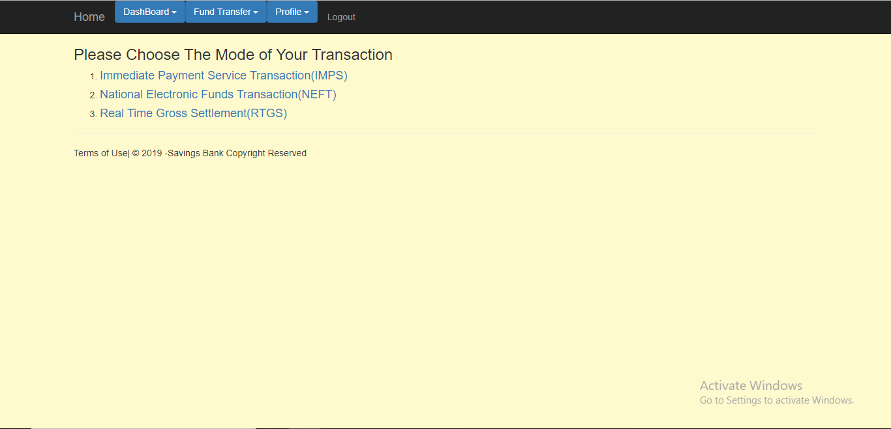
There are three modes of transactions. 1) IMPS 2) NEFT 3) RTGS

Slide 23
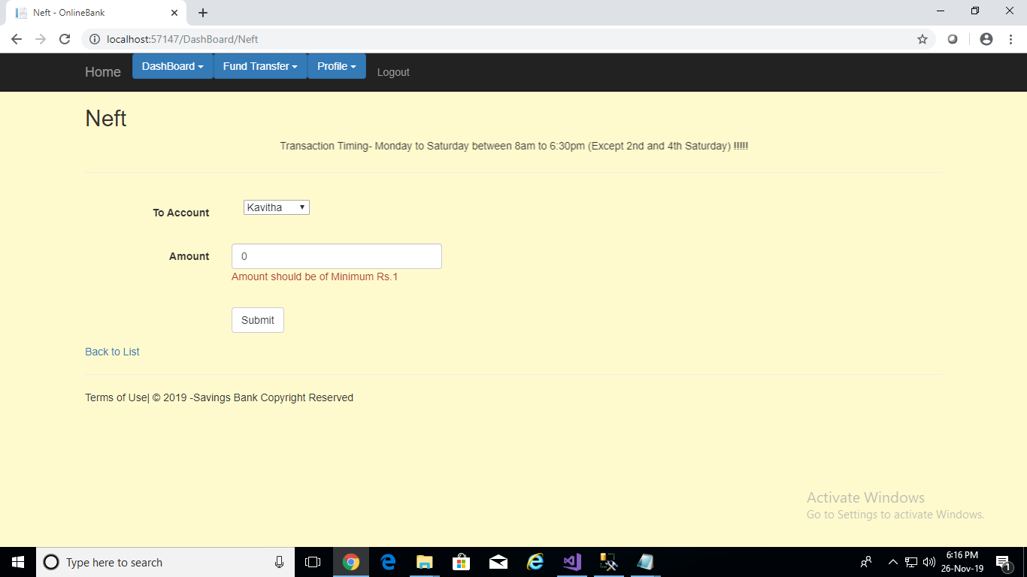
In NEFT , the user has to enter the beneficiary’s account number and amount. Minimum amount is Rs 1.

Slide 24
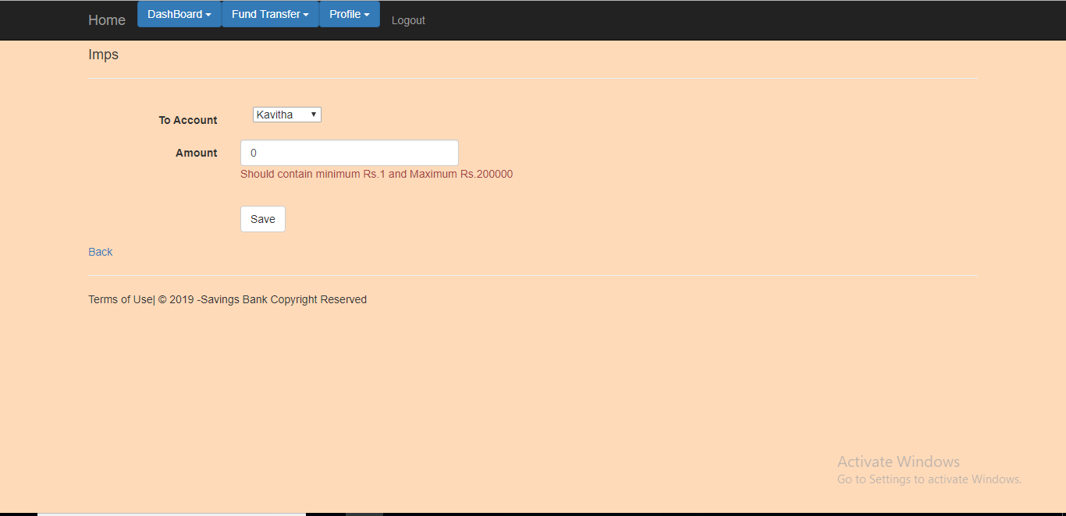
In IMPS, Minimum amount is Rs 1 and Maximum amount is Rs 2,00,000.

Slide 25
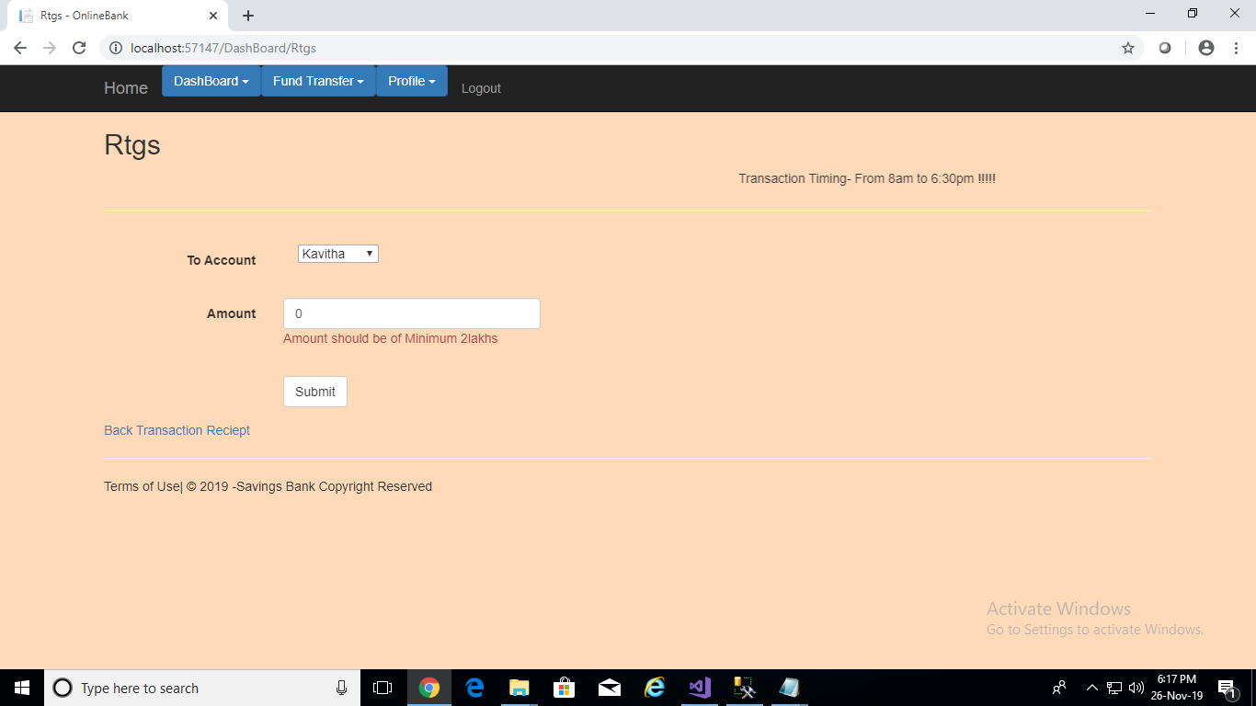
In RTGS, Minimum amount should be Rs 2,00,000.

Slide 26
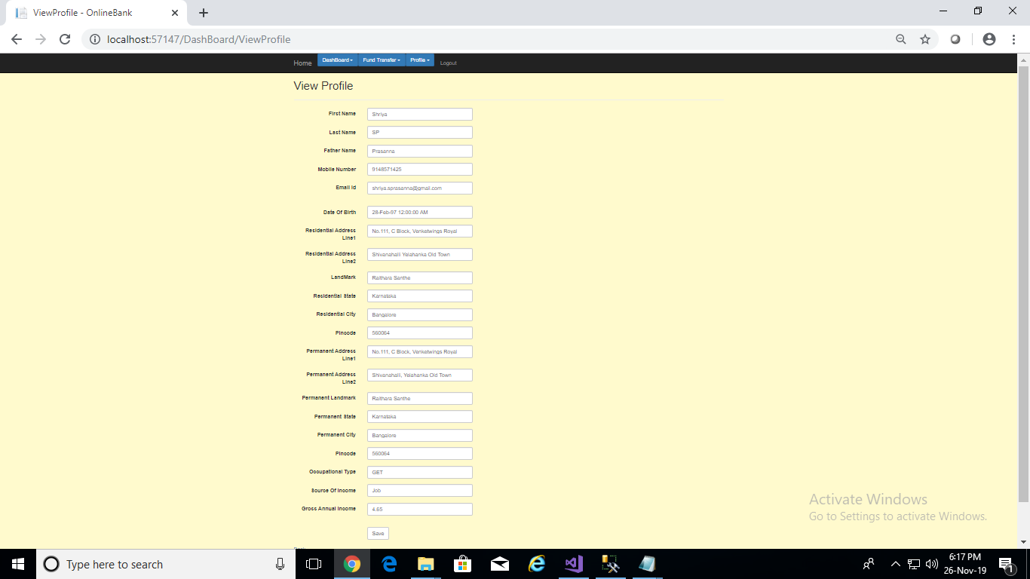
In ‘View Profile’ page ,the user can view and edit his/her details.

Slide 27
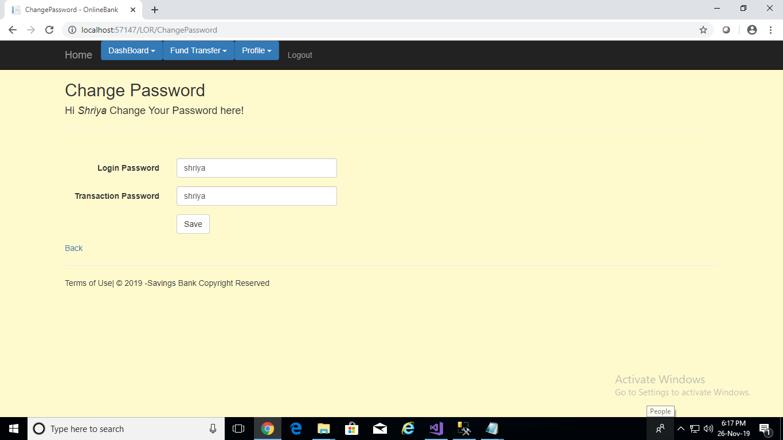
The user can change the passwords of Login and Transaction respectively in ‘Change Password ‘ page.

Slide 28
THANK YOU

